Slide 1
Quality Assurance Workstream
Building Confidence in Mojaloop Deployments
Presented by: Moses Kipchirchir, KPMG East Africa

Slide 2
Setting the Stage: Why Quality Matters for Mojaloop
Mojaloop is being adopted across markets as critical financial infrastructure.
Deployments must be secure, stable, and interoperable from day one.
A QA framework provides a structured approach to verify deployment readiness.
Quality is not just technical — it underpins trust, adoption, and scale.

Slide 3
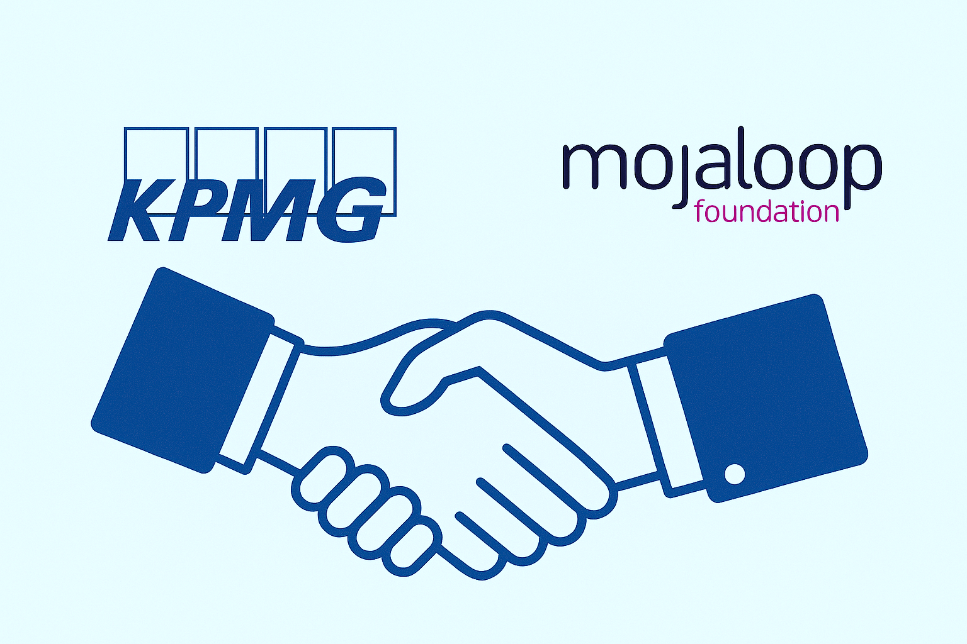
Workstream Context
The QA Assessment Framework is a new community-driven initiative.
Led by KPMG, with input from Mojaloop OSS teams and other stakeholders.
It offers a repeatable, consistent way to validate Mojaloop implementations.
Supports both self-assessment and external review for assurance.

Slide 4
What this framework aims to deliver
A practical, testable framework for evaluating Mojaloop deployments.
01
Six key QA pillars covering all critical areas.
02
Tools, checklists, and templates for hands-on validation.
03
A process that builds confidence across technical teams, regulators, and partners.
04

Slide 5
Defining Quality: The Six Pillars
Configuration Validation — correct setup, compliance, and environment readiness.
Functionality Testing — core payment flows (payments, error handling, business rules)
Security Assessment — encryption, access control, vulnerabilities, auditability.
Interoperability Readiness — API conformance, DFSP onboarding, directory services.
Performance & Scalability — throughput, load handling, recovery.
Project Governance — delivery discipline, scope control, risk and change management.

Slide 6
Work Plan
May 2025 – Kickoff and Requirements
Project launch, align on scope with Mojaloop leadership; gather QA needs and review existing tools/standards
June 2025 – Framework Definition
Define the QA pillars and quality criteria; map pillars to Mojaloop components & standards; draft initial framework design
July 2025 - Develop & Build:
Create detailed test cases for each pillar; develop QA toolkit (checklists, test scripts, templates, sample data)
August 2025 - Testing
Engage stakeholders on completed toolkit. Perform tests in environments.
Sept 2025 – Finalise and Handover
Incorporate final improvements; deliver the final framework documents and toolkit; conduct training & knowledge transfer to community

Slide 7
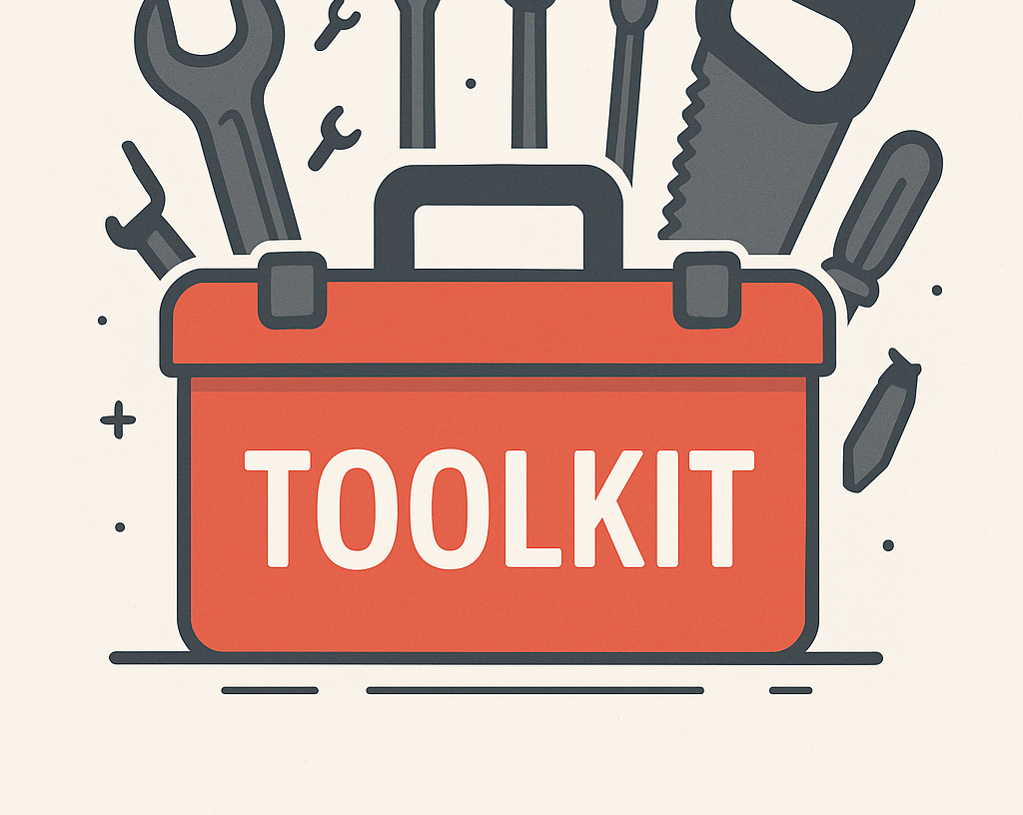
QA Framework toolkit
Pillar checklists and guidelines: Clear checklists under each QA pillar (configuration, security, etc.) detailing what to verify and how
Test case library: A set of concrete test scenarios for each area (e.g., specific functional tests, security test scripts, performance test plans)
Tools and templates: Templates (e.g., report templates, results logs) and possibly scripts or utilities
Self-certification toolkit: Guidance for adopters to run the assessment themselves – including how to use Mojaloop’s Testing Toolkit and other OSS tools for self-testing
Documentation and training materials: Framework reference document, user guide explaining how to conduct the QA assessment, and training decks for onboarding teams to the framework

Slide 8
The Road Ahead
2025
Community Review (Q3 2025): Stakeholder engagement on final framework
Oct. 2025
Official Release (October 2025): Publish the QA Framework and Toolkit for general use
2025
Adoption & Support (Q4 2025): Early adopters begin using the framework for new deployments
2026
Integration into Mojaloop Ecosystem (2026): Incorporate QA framework into Mojaloop’s standard adoption process
Ongoing
Maintenance: Define ownership for updating the toolkit

Slide 9
Thank you!

